Slide 1
R Programming Basics and Data management in R
Pablo E. Gutiérrez-Fonseca, PhD
University of Vermont
Fall 2024

Slide 2
What is R Programming?
R is data analysis software: data scientists, statisticians, analysts, quarts, and others who need to make sense of data use R for statistical analysis, data visualization, and predictive modeling.
R is a programming language: you do data analysis in R by writing scripts and functions in the R programming language.
R is a complete, interactive, object-oriented language: designed by statisticians, for statisticians.

Slide 3
Strengths and Weaknesses
Strengths
Free and Open Source
Strong User Community
Highly extensible, flexible
Implementation of high-end statistical methods
Flexible graphics and intelligent defaults
Weakness
Steep learning curve
Slow for large datasets
Notes:
R is a great software. It is freely distributed (free both in price as well as in freedom of usage, no restrictions). It has a very strong user community who are ready to help newbies and share information. It has extensive documentation. Best of all, it is extremely scalable, meaning from very low end to very high end, all types of statistical methods can be easily implemented using R. The graphics of R are very flexible and there are many intelligent defaults. Intelligent defaults mean R can guess what you are trying to do and act accordingly.
On the downside, it can be time-consuming to learn to use it effectively. The learning process is slow, sometimes frustrating, but in the end, it is a rewarding experience. However, for very large datasets, R can sometimes be slow, but there are several ways to speed up R. The newer versions are invariably faster than the older ones, so continuous upgrading of the software is a good way to speed things up.

Slide 4
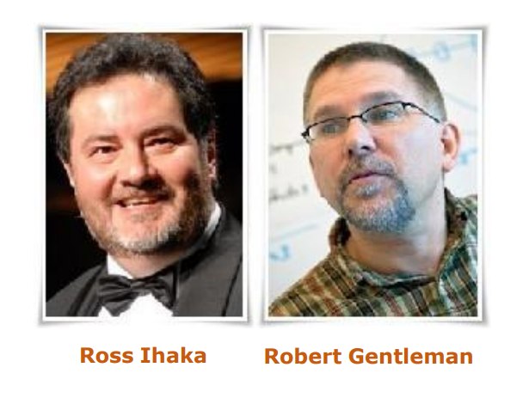
R Overview
R is a comprehensive statistical and graphical programming language and is a dialect of the S language:
1988 - S2: RA Becker, JM Chambers, A Wilks
1992 - S3: JM Chambers, TJ Hastie
1998 - S4: JM Chambers
R: initially written by Ross Ihaka and Robert Gentleman at Dep. of Statistics of U of Auckland, New Zealand during 1990s.
Since 1997: international “R-core” team of 15 people with access to common CVS archive.

Slide 5
How to download?
Google it using R or CRAN (Comprehensive R Archive Network)
http://www.r-project.org

Slide 6
How to download?
Having installed R, the next thing we will want to do is install RStudio, a popular and useful interface for writing scripts and using R.
If you google “RStudio” you will get to this window: https://www.rstudio.com/products/rstudio/download/
Rstudio is an integrated development environment (IDE) for R that allows users to interact more easily with R by integrating different aspects of scripting, from code completion to debugging.

Slide 7
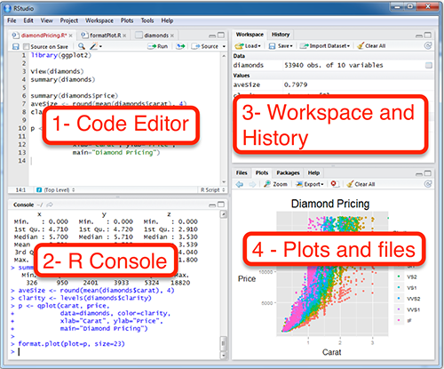
Typical Rstudio session
Workspace: Stores objects created during the session. Save with save.image().
History: Records commands used. Save with savehistory().
Contains code to tell R what to do. Save scripts for future use
Console: output & temporary input - usually unsaved
Plots: Displays graphs. Save plots with ggsave().
Files: Shows files in the working directory.

Slide 8
Data structures

Slide 9
Data structures
R is an object oriented programming language where an “object” is a generic term to describe something in R.
There are many types of R-objects.
Vectors
Lists
Matrices
Arrays
Factors
Data Frames

Slide 10
Data structures
Vectors in R
a sequence of elements of the same type (numeric, character, logical).
a <- c(1,2,3,4,5)
Command c creates a vector that is assigned to object a
Two vectors of the same lenght can be addedd (a+a), multiply (a*a)
Element in a vector can be sorter (sort())

Slide 11
Data structures
Factors in R
Categorical data structure with predefined levels.
b <- factor(c("low", 'medium', "high", 'very high'))

Slide 12
Data structures
R has three general classes for data:
list: collection of objects of different lengths or classes
matrix: vectors of the same length and same class
data.frame: vectors of the same length and different classes
Lists
A list is an R-object which can contain many different types of elements inside it like vectors, functions and even another list inside it.

Slide 13
Data structures
Matrices
A matrix is a two-dimensional rectangular data set.
It can be created using a vector input to the matrix function.

Slide 14
 | Linear | Rectangular
All Same Types | Vectors | Matrix
Mixed | List | Data Frame

Slide 15
Data structures
Data Frames
Data frames are tabular data objects.
Unlike a matrix in data frame each column can contain different modes of data.
The first column can be numeric while the second column can be character and third column can be logical.
It is a list of vectors of equal length.
Data Frames are created using the data.frame() function.
When we execute the above code, it produces the following result:

Slide 16
Reading data

Slide 17
Reading data
Command for reading in text files is:
read.table(”suomi.txt”, header=T, sep=”\t”)
This examples has one command with three arguments:
file name (in quotes)
header that tells whether columns have titles
sep that tells that the file is tab-delimited.

Slide 18
Reading data options
CSV File
Code: data <- read.csv("file.csv")
Usage: Reads comma-separated values, often used for structured data.
Text File
Code: data <- read.table("file.txt", header = TRUE, sep = "\t")
Usage: Reads tabular data from a text file; sep can be adjusted for different delimiters.
Excel File
library(readxl)
data <- read_excel("file.xlsx", sheet = 1)
Usage: Reads data from Excel files; you can specify the sheet number or name.

Slide 19
Reading data
getwd() # print the current working directory
setwd(mydirectory) # change to mydirectory
setwd("c:/docs/mydir")

Slide 20
Assigning Values in R
In R, you can assign values to objects using the syntax object <- value
An arrow (<-) formed by a smaller than character and a hyphen without a space!
The equal character (=).

Slide 21
Reading data
Subscripts are given inside square brackets after the object’s name:
df[,1]
Gets the first column from the object dat
df[,1]
Gets the first row from the object dat
df[1,1]
Gets the first row and it’s first column from the object dat

Slide 22
Reading data
Subscripts can be used for, e.g., extracting a subset of the data:
df[which(df$year>1900),]
Now, this takes a bit of pondering to work out…
First we have the object df, and we are accessing a part of it, because it’s name is followed by the square brackets
Then we have one command (which) that makes an evaluation whether the column year in the object df has a value higher than 1900.
Last the subscript ends with a comma, that tells us that we are accessing rows.
So this command takes all the rows that have a year higher 1900 from the object dat that is a data frame.

Slide 23
R Warning!
Naming objects:
R is a case sensitive language.
FOO, Foo, and foo are three different objects
Object names can’t start with a number
Never use special characters, such as å, ä, or ö in object names.

